Slide 1



Audio Amplifier
Bandwidth [16, 2048] Hz, output [4, 6] Volts and output resistance 35 ohms
Student: Pleș Andrei-Valentin
Group: 2022
Course: Computer Aided Graphic Design
Coordinator: Raul-Traian Fizeșan

Slide 2
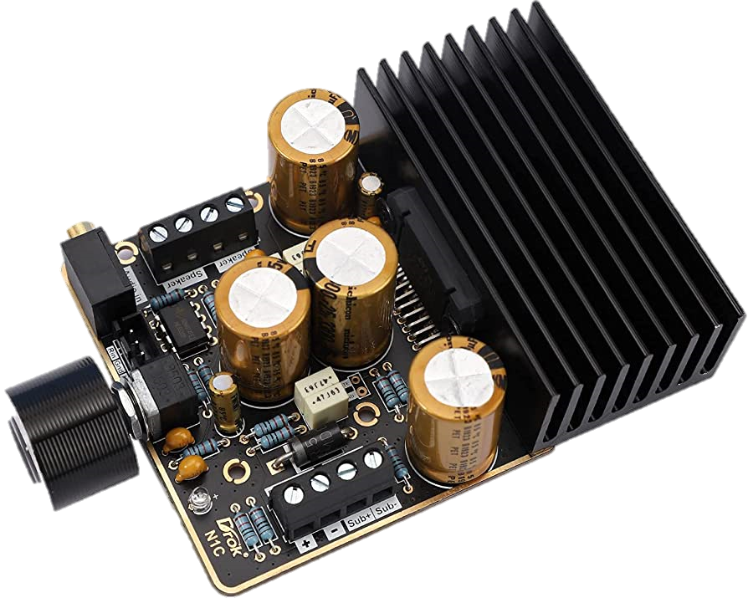
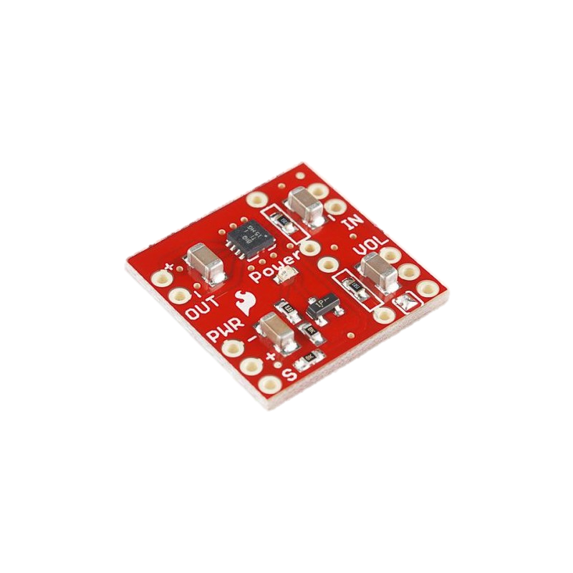
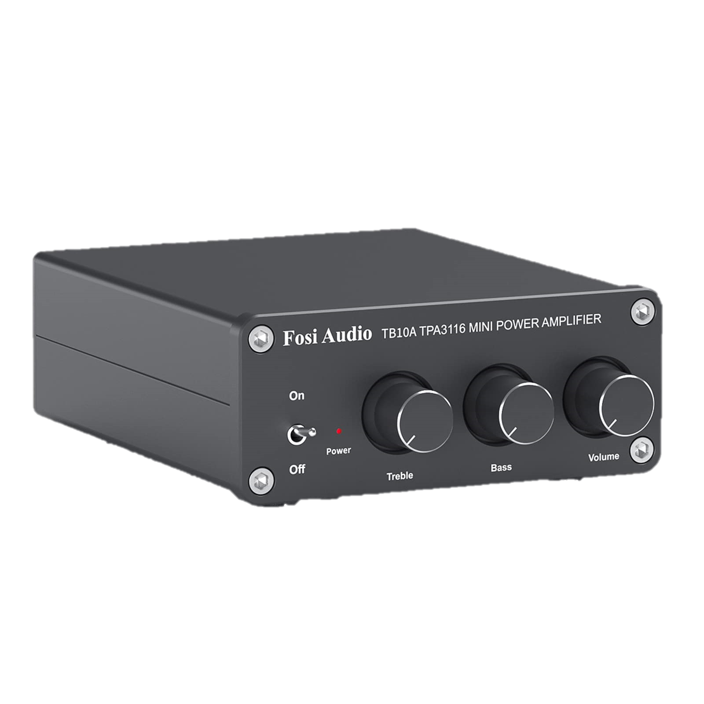
Design and overview
Frequency response, gain, noise, and distortion are key parameters for audio amplifiers.
These are interdependent - increasing gain often leads to undesirable increases in noise, distortion. Most audio amplifiers are linear amplifiers operating in class AB.
Choosing an audio amplifier will depend on the application, the required power output, the desired sound quality, and other factors such as size, weight, and cost.

Slide 3
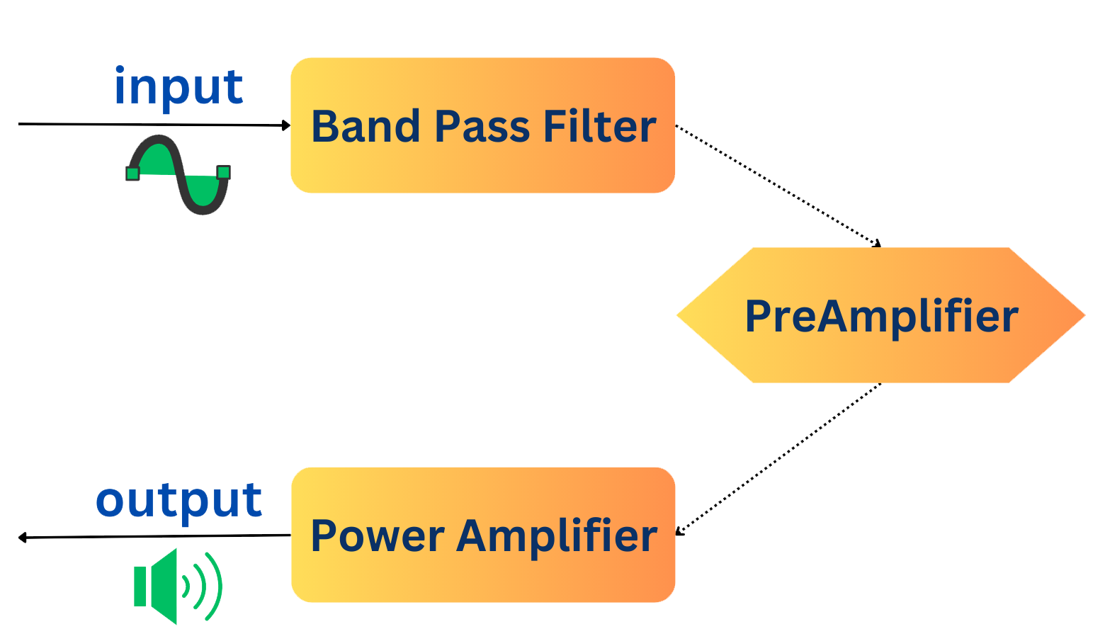
BLOCK DIAGRAM

Slide 4
FILTERING
Low-pass filter
High-pass filter
The input signal of the circuit can have a very large range of frequencies. Amplifying this signal and sending it to a speaker without any filtering will result in distorted audio.
Passive bandpass filters can be made by connecting a low-pass filter with a high-pass filter.

Slide 5
PREAMPLIFIER
Used for boosting and enhancing low-level audio signals.
When working with extremely low input voltage, a preamplifier stage is necessary to raise the voltage and ensure the power amplifier will function properly.
OPA2604 has very low distortion and low noise.
Ideal calculated gain is a maximum of 121*136≈16500. The final voltage gain ranges from ~5710 to ~8710

Slide 6
Power amplifier
A class AB power amplifier is used for its good efficiency compared to class A, low distortion compared to class C or B, and simplicity compared to class D.
This implementation also includes short-circuit protection. transistors Q3 and Q4 will limit the current to ~300mA, protecting the circuit.

Slide 7
Circuit diagram

Slide 8
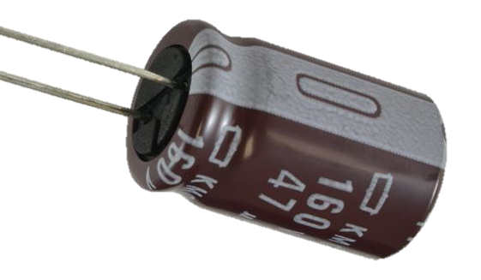
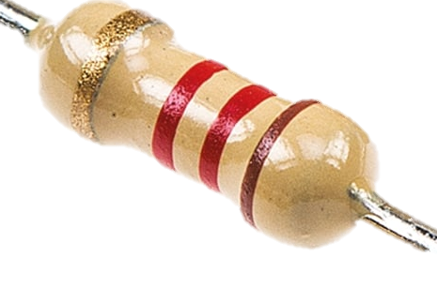
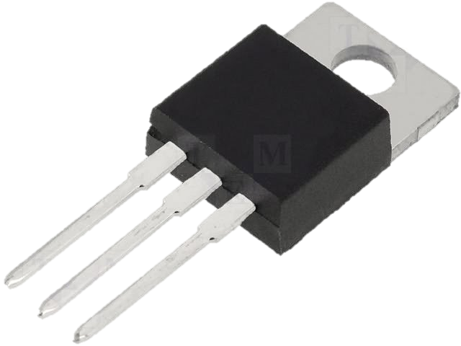
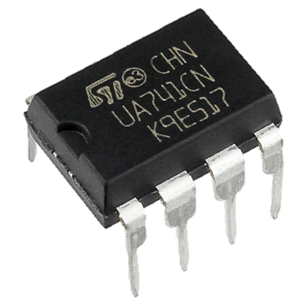
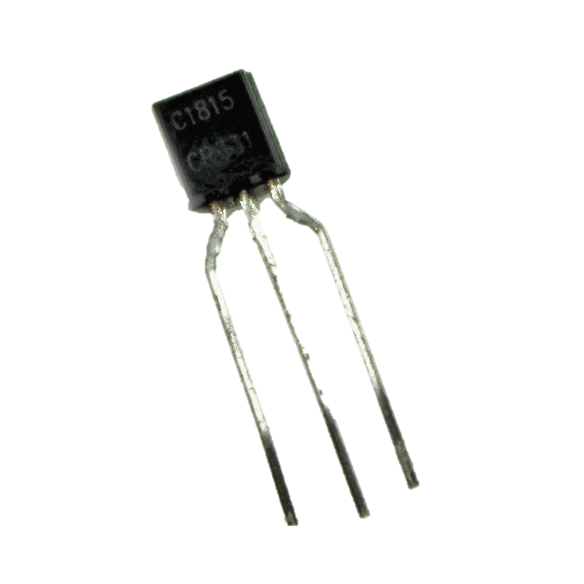
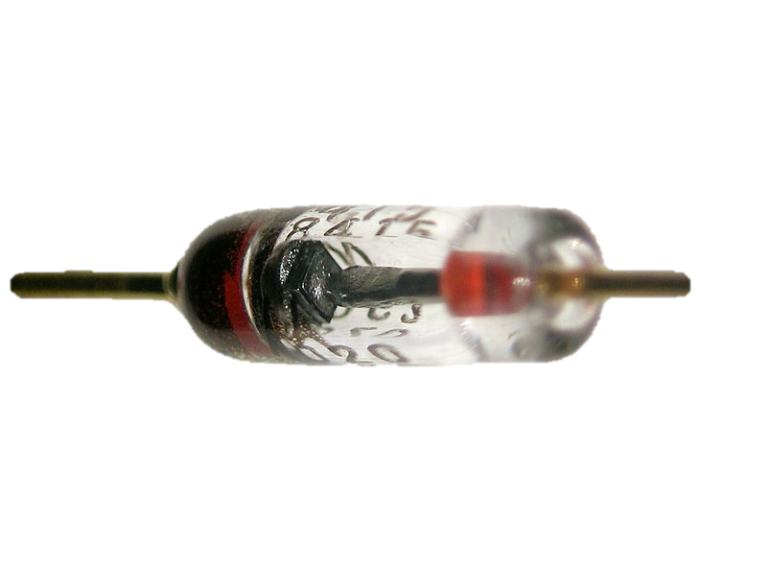
Cost of components
Total cost for the audio amplifier is 7.788$. Most of the cost is represented by the high performance operational amplifier OPA2604 (61.6% of the total value).
Resistors: 1.245$
Capacitors: 0.383$
Diodes: 0.56$
Transistors: 0.8$
Operational Amplifiers: 4.8$

Slide 9
Time domain simulation
Sweep of SET in time.
Output ranges from 3.97V to 6V.

Slide 10
AC SWEEP
1Hz up to 10kHz
Cutoff of high-pass is 16.04 Hz. (0.25% error)
Cutoff of low-pass is 2060 Hz. (0.58% error)

Slide 11
Temperature performance
Output at 20°C is 5.08 V.
Within 4.46% of this value between -150°C and 65°C
temperature sweep was run for [-170 -150 20 65 80] °C

Slide 12
Monte carlo
Monte Carlo determines, statistically, the circuit’s behavior when the components values are changed within their tolerance domain

Slide 13
Worst case and noise
Performance of the circuit under worst-case conditions: 1,97% difference in output voltage.
Maximum value of the NTOT(ONOISE) trace is only 6.02n

Slide 14
references
Thomas L. Floyd, Electronic Devices, 1984
Circuit digest website, https://circuitdigest.com
Electronics-tutorial website, https://www.electronics-tutorials.ws
Technology world website, https://www.5gtechnologyworld.com
Power electronic website, https://www.powerelectronictips.com
Analog website, https://www.analog.com
Canva website, https://www.canva.com
Homemade Circuits website, https://www.homemade-circuits.com
Texas Instruments website, https://www.ti.com
Fundamental Electronic Circuits course, Prof.dr.ing. Gabriel OLTEAN
„OPA2604 Datasheet”, Texas Instruments
Electronic Devices course, Assist. prof. Laura-Nicoleta IVANCIU, Ph.D.
Computer Aided Design course, S.l.dr.ing. Raul Fizesan
Electronics|Projects|Focus website, https://www.elprocus.com
„1N3493 Datasheet”, Microsemi Corporation
„2N5088 Datasheet”, Fairchild Semiconductor
DEPARTAMENTUL BAZELE ELECTRONICII website, http://www.bel.utcluj.ro
Instructables website, https://www.instructables.com
Youtube website, https://www.youtube.com
Wikipedia website, https://en.wikipedia.org
Amazon website, https://www.amazon.com
Pspice website, https://www.pspice.com
LibreTexts PHYSICS website, https://phys.libretexts.org
Learnabout Electronics website, https://learnabout-electronics.org/Amplifiers
„ClassB and ClassAB amplifier Design” course, Richard Cooper, March 30 2020
Mouser electronics website, https://ro.mouser.com

